Slide 1
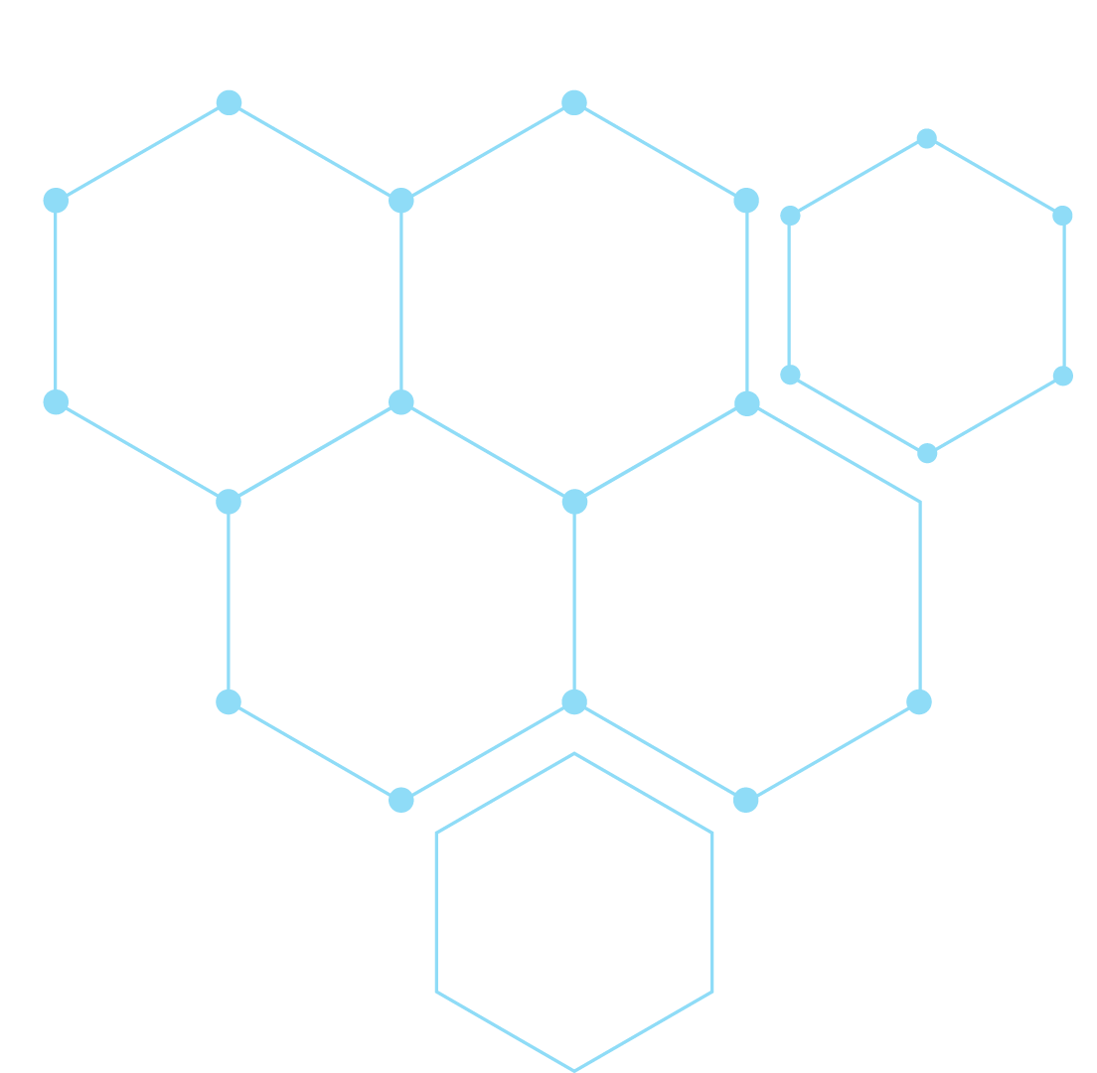
Adaptive Weighted Voting KNN: A Hybrid
Clustering Method for Mixed Data
Marina Lin, Clinton Morimoto

Slide 2
Table of contents
01
02
03
04
INTRODUCTION
DATASET
METHODOLOGY
RESULTS

Slide 3
01
INTRODUCTION
Primary Problem & Motivation

Slide 4
Problem
Loan Approval
Impacts individuals’ access to funds and institutions’ ability to manage risk
Significant financial losses for institutions
Misjudgments
Rejecting creditworthy applicants
Limit economic growth and aspirations

Slide 5
Previous Approaches
Previous works experimented with different distance metrics:
Mixed weighting approaches with inversely proportional weights
Manhattan, Minkowski, Mahalanobis, Cosine, etc.
Useful for imbalanced class labels

Slide 6
02
DATASET
Dataset Description, Preprocessing, Train/Test Split

Slide 7
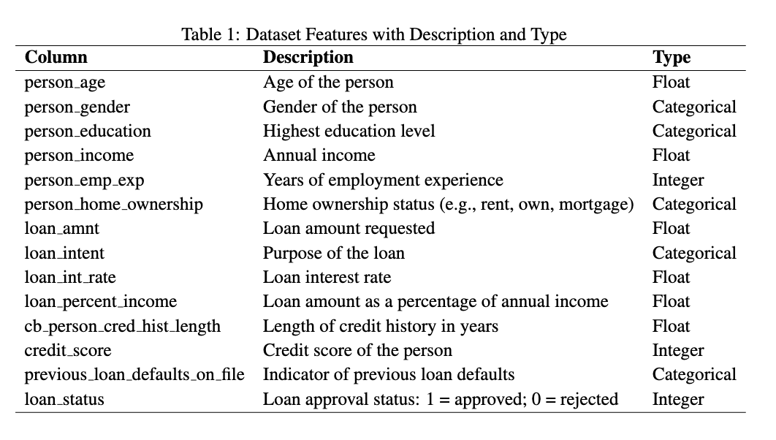
Loan Classification Dataset
Categorical and Numeric Types, 13 features
Loan Approval Status; 1 = approved, 0 = rejected

Slide 8
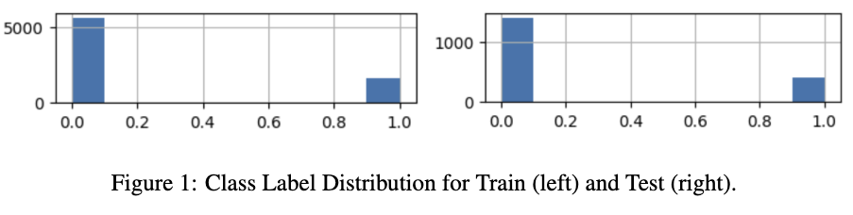
Preprocessing
45000 Total Instances
10000 Instances that are approved loans, 35000 unapproved
After preprocessing with normalization and type conversion
9000 Total Instances
2022 Instances that are approved loans, 6978 unapproved
Train/Test Split: 80/20

Slide 9
03
METHODOLOGY
KNN, Mixed Data, Our extension

Slide 10
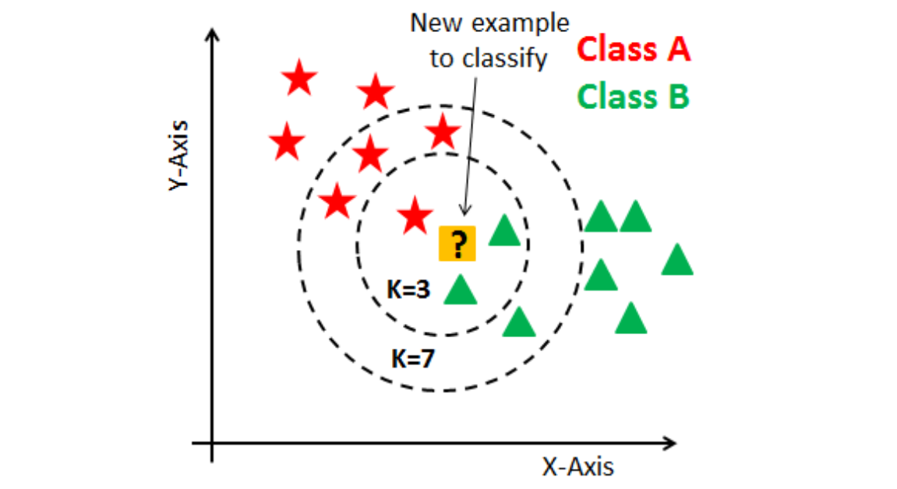
KNN

Slide 11
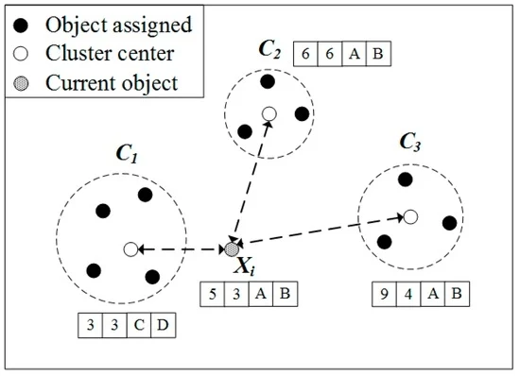
KNN Algorithm for Mixed Data
Three classes, 𝐶={𝐶₁, 𝐶₂, 𝐶₃}.
Points from each class are:
𝐶₁=(3,3,𝐶,𝐷)
𝐶₂=(6,6,𝐴,𝐵)
𝐶₃=(9,4,𝐴,𝐵)

Slide 12
KNN Algorithm for Mixed Data
Calculates distance with each point to find the class to which 𝑋ᵢ = (5, 3, A, B) is assigned.
The distance about the numerical attribute of 𝑋ᵢ
and 𝐶₁, 𝐶₂, 𝐶₃ is
(3−5)^2+(3−3)^2=4
(6−5)^2+(6−3)^2=10
(9−5)^2+(4−3)^2=17.

Slide 13
KNN Algorithm for Mixed Data
The distance about the categorical attribute of 𝑋ᵢ and 𝐶₁, 𝐶₂, 𝐶₃ is
1 +1=2 ∵C≠A, 𝐷≠B
0 +0=0 ∵A=A, B=B,
The total distance of 𝑋ᵢ to 𝐶₁, 𝐶₂, 𝐶₃ is 6, 10, and 17, respectively.

Slide 14
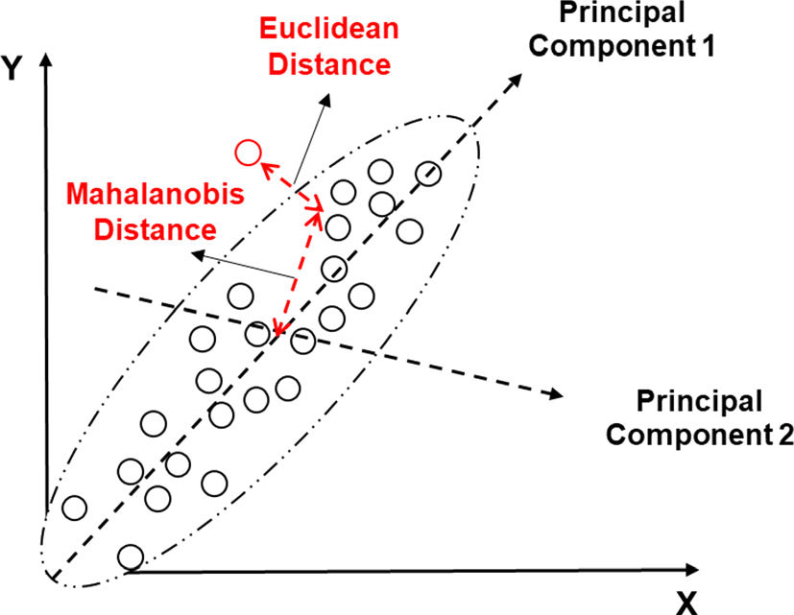
Extension
Mahalanobis distance
Weighted Voting
Weight Minority Label Higher
Accumulate weights for each class c among the k-nearest neighbors
Assign the class with the highest accumulated weight
Notes:
The Mahalanobis distance adjusts for the spread and orientation of the data by using the covariance matrix.
Instead of measuring the straight-line distance, it "scales" the distance by the variance in each direction. It effectively normalizes the data along the elliptical axes.
For example, the point farther along the major axis (where variance is large) may have a smaller Mahalanobis distance than a point closer but along the minor axis (where variance is small).

Slide 15
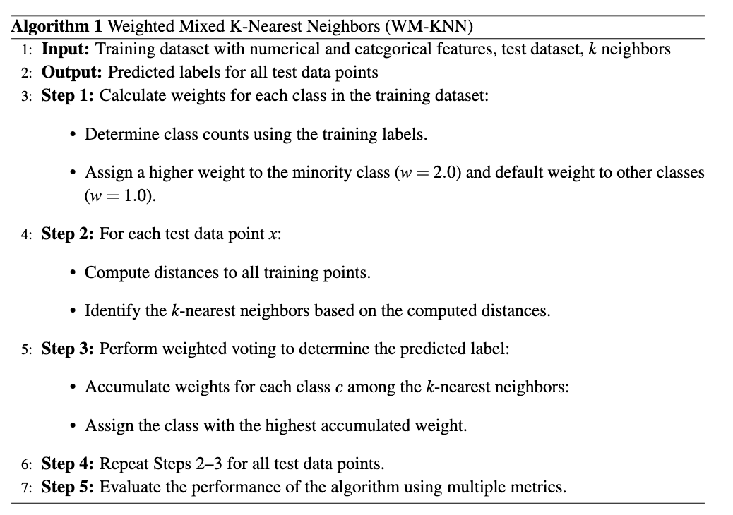
Pseudocode

Slide 16
04
RESULTS
Performance of our proposed algorithm.

Slide 17
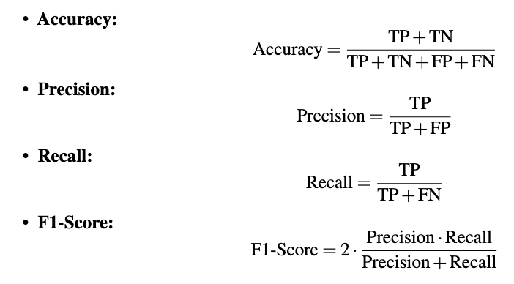
Performance Metrics
k = 85

Slide 18
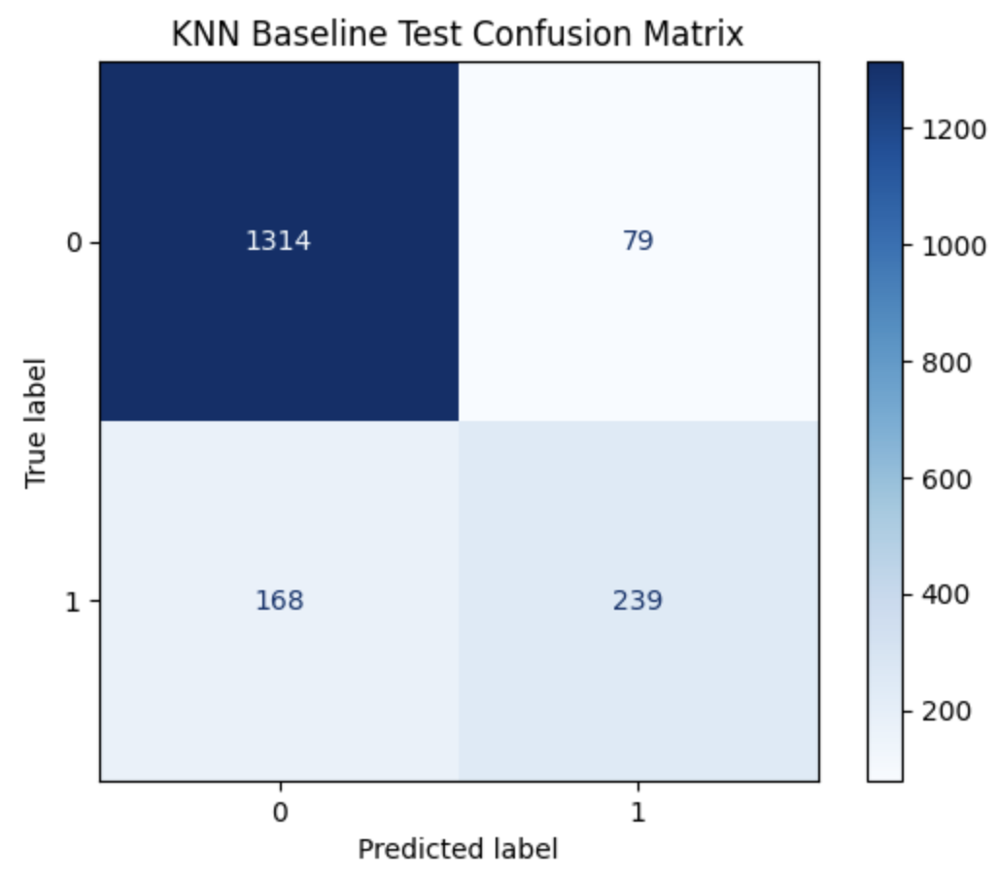
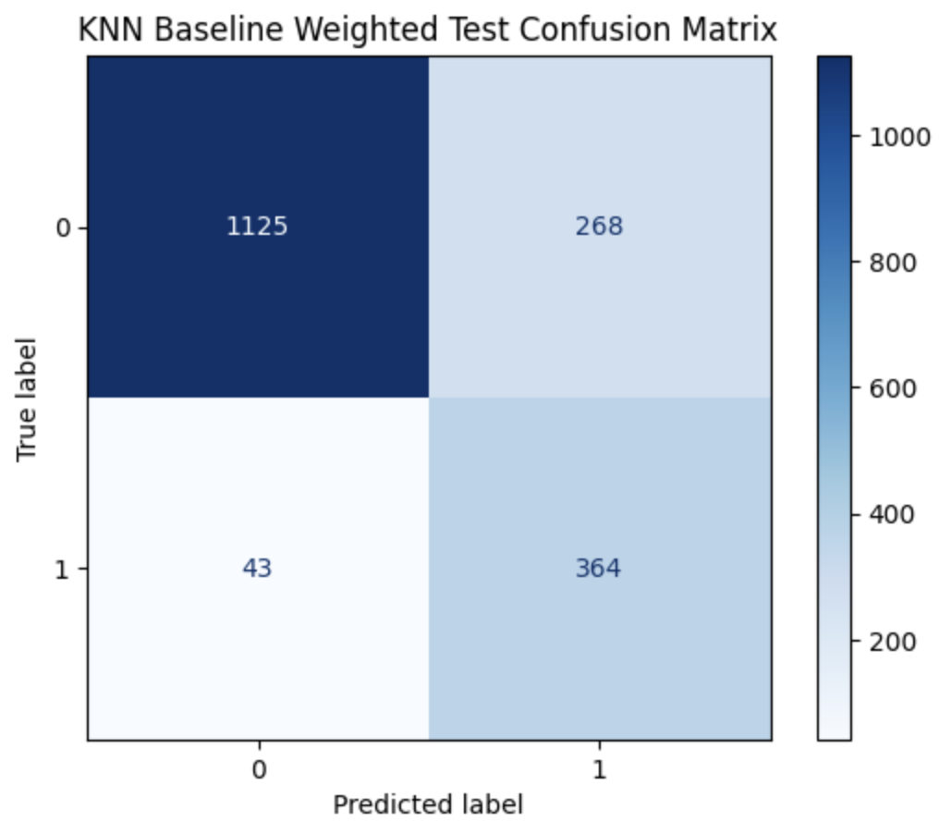
Mixed KNN w/Euclidean

Slide 19
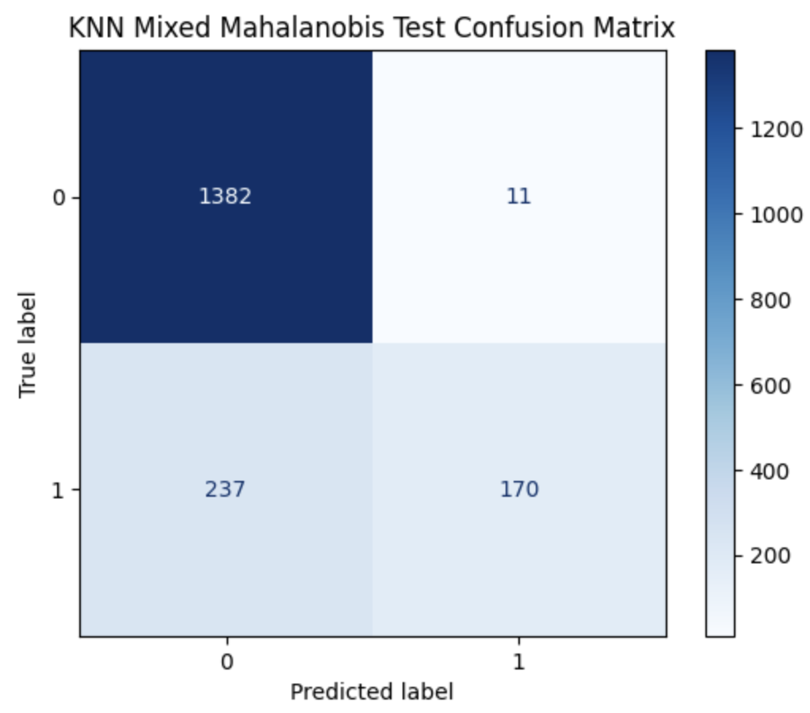
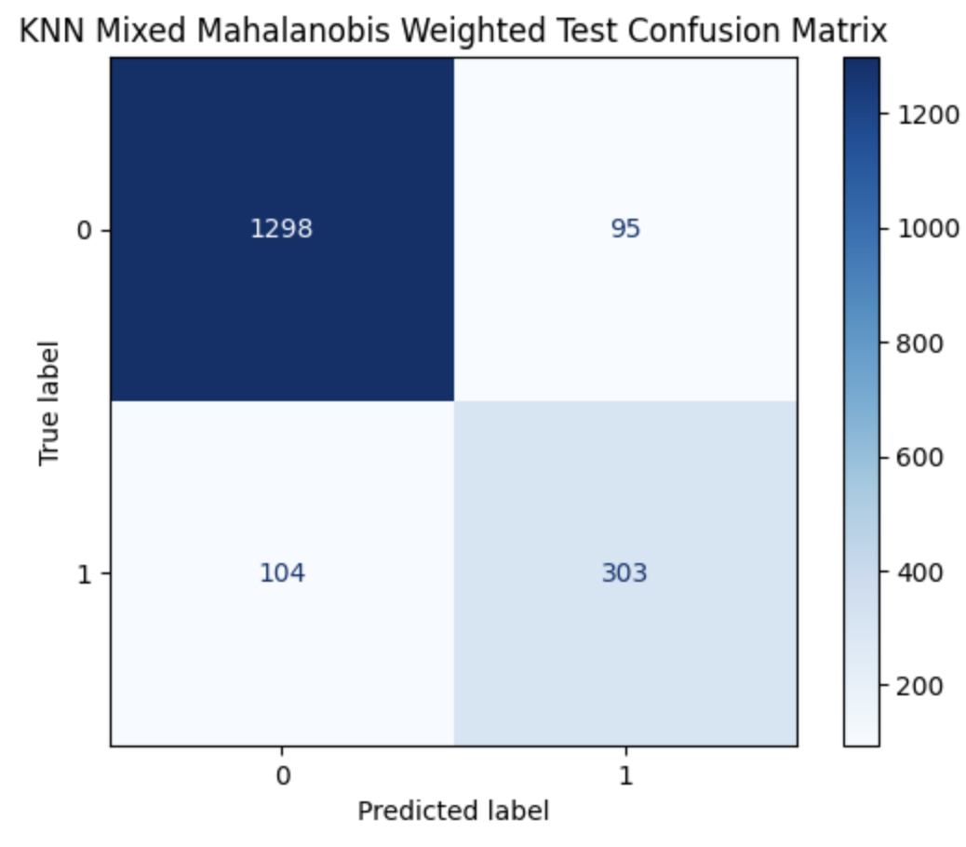
Mixed KNN w/Mahalanobis

Slide 20
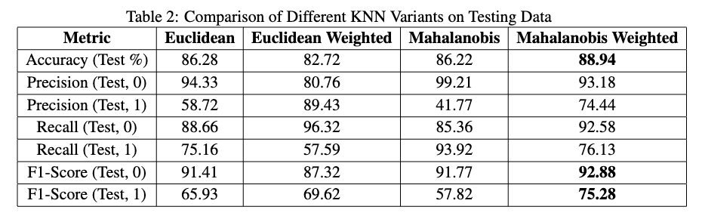
Algorithm Comparison
1 = approved, 0 = rejected

Slide 21
Conclusion
Developed a new Hybrid KNN Clustering Method for Mixed Data
Mixing Two Techniques for improved performance
Adaptive Weighted Voting
Mahalanobis Distance Metric
Improvement in Accuracy, F1-Score, and achieved good balance for other metrics

Slide 22
Thank you!

